Slide 1
How to start the MMM Case Study
Researching code and reverse engineering

Slide 2
Creating The-Blop
The narrative for what to do and where to look is in <MMM The Assignment.docx>.
Consider the specifications needed for The-Blop and use Dinosaur.java as a model/template.
public class Dinosaur extends Monster //in Dinosaur.java { //ARGS: row, col, image collection public Dinosaur(int r, int c, String[][][] image) { super("Gobzilly", r, c, image, 15, 50, 1, 100, 20, "FIRE", 5); setIsSwimmer(true); //we can swim fast setIsShooter(true); //we can shoot a projectile (FIRE) setHealInWater(true); //we can heal in water setCanEatAll(true); //we can grab and eat every type of unit } //ARGS: name, row loc, col loc, image collection, stomp power, speed penalty, reload time public Dinosaur(String n, int r, int c, String[][][] image, int sp, int spp, int rt) { super (n, r, c, image, 15, sp, spp, rt, 20, "FIRE", 5); setIsSwimmer(true); setIsShooter(true); setHealInWater(true); setCanEatAll(true); }
public class Blop extends Monster //in Blop.java { //ARGS: row, col, image collection public Blop(int r, int c, String[][][] image) {
} //ARGS: name, row loc, col loc, image collection, stomp power, speed penalty, reload time public Blop(String n, int r, int c, String[][][] image, int sp, int spp, int rt) {
}

Slide 3
Creating The-Blop
The narrative for what to do and where to look is in <MMM The Assignment.docx>.
Consider the specifications needed for The-Blop and use Dinosaur.java as a model/template.
public class Dinosaur extends Monster //in Dinosaur.java { //ARGS: row, col, image collection public Dinosaur(int r, int c, String[][][] image) { super("Gobzilly", r, c, image, 15, 50, 1, 100, 20, "FIRE", 5); setIsSwimmer(true); //we can swim fast setIsShooter(true); //we can shoot a projectile (FIRE) setHealInWater(true); //we can heal in water setCanEatAll(true); }
public class Blop extends Monster //in Blop.java { //ARGS: row, col, image collection public Blop(int r, int c, String[][][] image) {
}

Slide 4
Creating The-Blop
The narrative for what to do and where to look is in <MMM The Assignment.docx>.
Consider the specifications needed for The-Blop and use Dinosaur.java as a model/template.
public class Dinosaur extends Monster //in Dinosaur.java { //ARGS: row, col, image collection public Dinosaur(int r, int c, String[][][] image) { super("Gobzilly", r, c, image, 15, 50, 1, 100, 20, "FIRE", 5); setIsSwimmer(true); //we can swim fast setIsShooter(true); //we can shoot a projectile (FIRE) setHealInWater(true); //we can heal in water setCanEatAll(true); }
public class Blop extends Monster //in Blop.java { //ARGS: row, col, image collection public Blop(int r, int c, String[][][] image) {
}
/* Call to the super constructor for Monster should be invoked first: use the values sent as arguments from the assignment document.
Note: make sure to use the exact values in the document, even for the name “The-Blop”. Setting it to something different can affect any code that is looking for that exact name in particular. */

Slide 5
Creating The-Blop
The narrative for what to do and where to look is in <MMM The Assignment.docx>.
Consider the specifications needed for The-Blop and use Dinosaur.java as a model/template.
public class Dinosaur extends Monster //in Dinosaur.java { //ARGS: row, col, image collection public Dinosaur(int r, int c, String[][][] image) { super("Gobzilly", r, c, image, 15, 50, 1, 100, 20, "FIRE", 5); setIsSwimmer(true); //we can swim fast setIsShooter(true); //we can shoot a projectile (FIRE) setHealInWater(true); //we can heal in water setCanEatAll(true); }
public class Blop extends Monster //in Blop.java { //ARGS: row, col, image collection public Blop(int r, int c, String[][][] image) {
}
/* The-Blop has different abilities. Try to find where the dinosaur’s set-methods are defined so you can find the ones that The-Blop needs. You won’t find them in Monster, so where must they be? */

Slide 6
Creating The-Blop
The narrative for what to do and where to look is in <MMM The Assignment.docx>.
Consider the specifications needed for The-Blop and use Dinosaur.java as a model/template.
public class Dinosaur extends Monster //in Dinosaur.java { public Dinosaur(String n, int r, int c, String[][][] image,
int sp, int spp, int rt) { super (n, r, c, image, 15, sp, spp, rt, 20, "FIRE", 5); setIsSwimmer(true); setIsShooter(true); setHealInWater(true); setCanEatAll(true); }
public class Blop extends Monster //in Blop.java { public Blop(String n, int r, int c, String[][][] image,
int sp, int spp, int rt) {
}
/* Also define the 7-argument constructor in a similar way. The different constructors are used for different game-modes */

Slide 7
Creating The-Blop
Use the Dinosaur’s other methods as models for The-Blop
Keep in mind what needs to be different for the new monster, and what is abstract in the base-class.
public class Dinosaur extends Monster //in Dinosaur.java { //returns true if the monster can grab the unit //Gobzilly can grab any kind of boat public boolean canGrabUnit(String name) { if(name.startsWith("CYCLE") || name.startsWith("CAR")
|| name.startsWith("CROWD") || name.startsWith("BOAT")
|| name.equals("AIR newscopter")) return true; return false; }
public class Blop extends Monster //in Blop.java { //returns true if the monster can grab the unit //The-Blop can grab everything public boolean canGrabUnit(String name) {
}
/* We can do this one with a single return statement. Good times. */

Slide 8
Creating The-Blop
Use the Dinosaur’s other methods as models for The-Blop
Keep in mind what needs to be different for the new monster, and what is abstract in the base-class.
public class Dinosaur extends Monster //in Dinosaur.java { //grabs a unit of type specified by name public void grabUnit(String name) { super.setClawContents(name); }
public class Blop extends Monster //in Blop.java { //grabs a unit of type specified by name public void grabUnit(String name) { super.setClawContents(name); }
/* This method doesn’t need to change at all.
More good times. */

Slide 9
Creating The-Blop
Use the Dinosaur’s other methods as models for The-Blop
Keep in mind what needs to be different for the new monster, and what is abstract in the base-class.
public class Dinosaur extends Monster //in Dinosaur.java { public void eatUnit() { String[] contents = super.getClawContents(); int index = -1; if(!contents[0].equals("empty")) index = 0; else if(!contents[1].equals("empty")) index = 1; if(index >= 0) { if(super.getHunger() > 0) super.setHunger(super.getHunger()-1); if(contents[index].startsWith("CROWD")
|| contents[index].endsWith("destroyer")) super.setHunger(0); else if(contents[index].endsWith("bus")) super.setHunger(super.getHunger()-2); else super.setHunger(super.getHunger()-1); super.clearClawContents();
public class Blop extends Monster //in Blop.java { public void eatUnit() {
/* The basic structure is the same, but:
The-Blop has different rules for how much health gets gained and hunger satisfied as dictated in the assignment document. */

Slide 10
Creating The-Blop
Use the Dinosaur’s other methods as models for The-Blop
Keep in mind what needs to be different for the new monster, and what is abstract in the base-class.
public class Dinosaur extends Monster //in Dinosaur.java { public String reloadingMessage() { return "Out of breath!"; }
public class Blop extends Monster //in Blop.java { public String reloadingMessage() { return “Generating glop!"; }
/* This method is only used for the Earth-Invaders
game mode. You can set the message to
anything you want (class appropriate). */

Slide 11
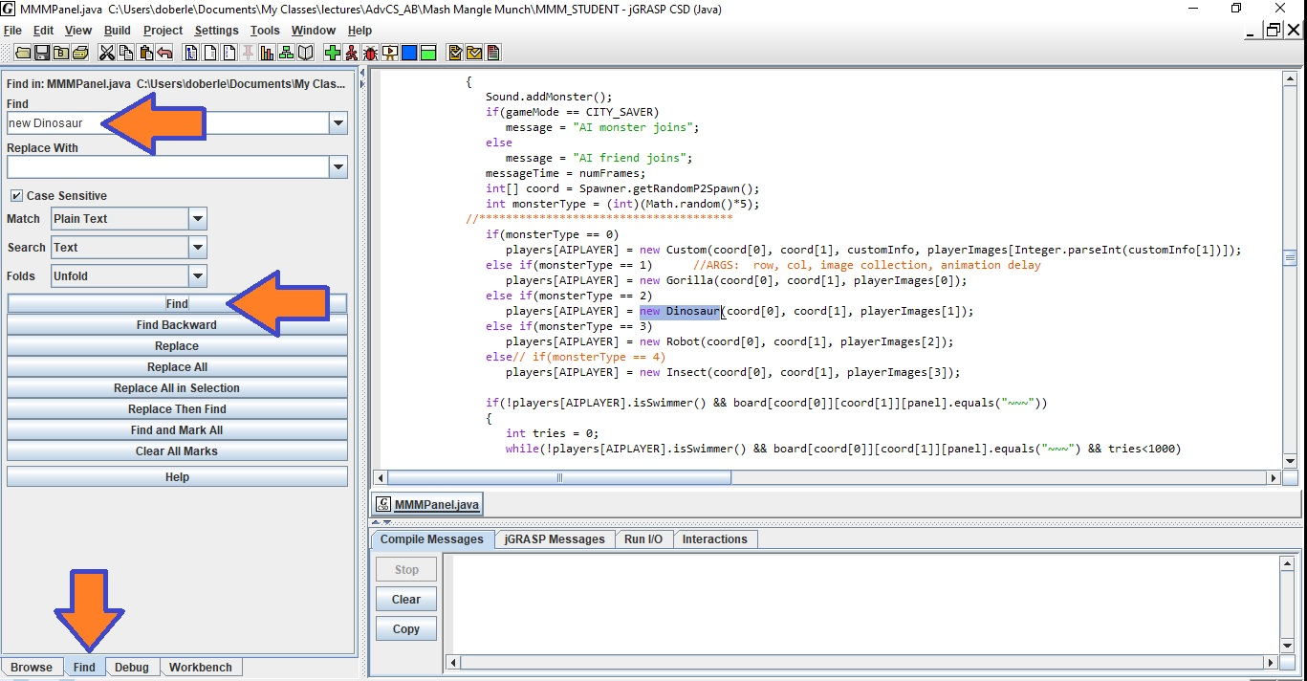
Editing the jPanel: constructing a Blop
Now it is time to create instances of Blops in the game.
Search for every place a new Dinosaur is created.
Create a new instance of a Blop in those same places.
Make sure to pass the correct arguments as needed.
There are several places where monster constructors are called for different game-modes.
For one game mode, the arguments are the same for every monster.

Slide 12
Getting the game to start for The-Blop
Ok – we created the Blop DNA in Blop.java, and added a call to the constructor for a Blop in all the places that other monsters are created.
The game still does not start when we select the Blop. Why?
We see 5 places with code like this:
if(monsterType == 1) //name, row, col, anim images, anim speed, stomp power, speed penalty, reload time players[PLAYER1] = (new Gorilla("King-Clunk", coord[0], coord[1], playerImages[0], 100, 0, 30)); else if(monsterType == 2) players[PLAYER1] = (new Dinosaur("Gobzilly", coord[0], coord[1], playerImages[1], 100, 0, 30)); else if(monsterType == 3) players[PLAYER1] = (new Robot("BoobooTron", coord[0], coord[1], playerImages[2], 100, 0, 30));
Note that this code only calls the appropriate constructor type depending on the state of the variable monsterType.
We need to find where monsterType is assigned, and make sure that the Blop gets the value 5 assigned to it. So, search for monsterType. HURRY UP!

Slide 13
Getting the game to start for The-Blop
Search for the place where the variable monsterType is assigned.
Click on the Find-tab in the lower-left corner.
In the Find-field in the upper-left corner, search for monsterType
Continue to click the Find button in the middle of the left-side until you find the code that assigns values for the monsterType and sets the game so that it can start.
From the code where the constructor’s are called, you might have figured that The-Blop’s monsterType is 5.
You need to make sure that the monsterType gets set to 5 if someone selects The-Blop and the game is allowed to start.

Slide 14
Getting the game to start for The-Blop
else if(k==KeyEvent.VK_2) //hit 2 key { monsterType = 2; //select Gobzilly needToStart = true;
} else if(k==KeyEvent.VK_3) //hit 3 key { monsterType = 3; //select BoobooTron needToStart = true; } else if(k==KeyEvent.VK_4) //hit 4 key { monsterType = 4; //select WoeMantis needToStart = true; } else if(k==KeyEvent.VK_5) //hit 5 key - pick random vehicle or The-Blop { if(gameMode == CITY_SAVER) { monsterType = (int)(Math.random()*4); needToStart = true; }
/* We want to keep the same code for CITY_SAVER where it selects a random vehicle.
But if the game mode is not CITY_SAVER, we want to make sure that the mosterType gets set to the correct value for The-Blop and that the game gets set to start. */

